Slide 1
Unit - VI
Managing Devices : Identify the types of linux devices, Configure devices, Monitor devices, Troubleshoot hardware issues
Managing Networking : Identify TCP/IP fundamentals, Identify linux server roles, Connect to a network, Configure DHCP and DNS client services, Configure cloud and virtualization technologies, Troubleshoot networking issues

Slide 2
Identify the Types of Linux Devices
THIN CLIENTS: A client device, typically referred to as a thin client, is any lightweight computing device that connects to a more powerful server for doing work. The server does most of the heavy lifting, including processing and storing data, while the thin client acts as little more than a user interface.

Slide 3
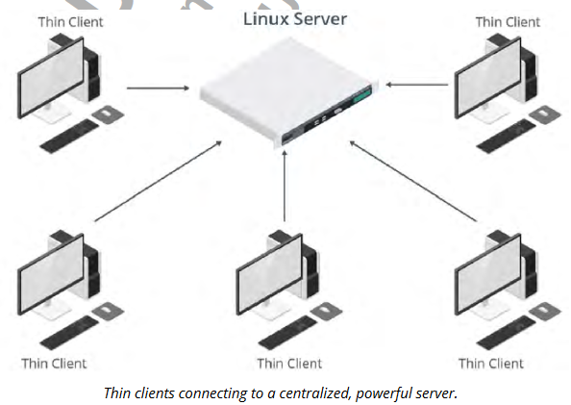

Slide 4
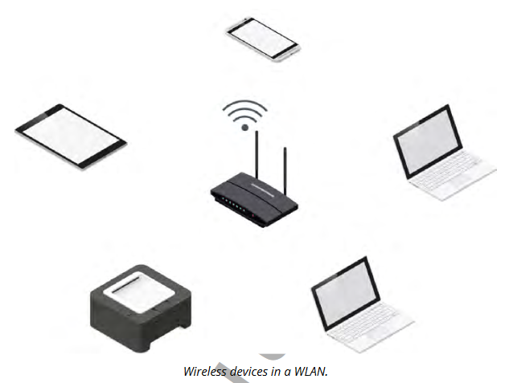
USB DEVICES
WIRELESS DEVICES

Slide 5
VIDEO AND AUDIO DEVICES
PRINTERS
NETWORK ADAPTERS
GPIO: General-purpose input/output (GPIO) refers to pins on a circuit board that have no designated purpose, but are controllable by the user at runtime. These pins send and receive digital signals and can be in an on or off state.

Slide 6
SATA
SCSI
HBA: A host bus adapter (HBA) is a hardware component that connects a host system to a storage device
PCI

Slide 7
Configure Devices
Use Linux tools to configure devices. use some common services that enable you to customize how the system interacts with certain hardware.

Slide 8
A hotpluggable device can be physically added or removed from the system without requiring a reboot in order to use that device. Hotpluggable devices are detected by the system as they are plugged in, whereas coldpluggable devices, such as RAM modules, CPUs, and some internal storage devices, are not sensed when connected to a running system; they need a complete reboot of the system to function.

Slide 9
udev
The device manager udev manages the automatic detection and configuration of hardware devices.
THE udevadm COMMAND: The udevadm command is used to manage udev. It takes various subcommands, each of which performs a certain task.

Slide 10
CUPS
CUPS is a print management system for Linux that enables a computer to function as a print server.

Slide 11
THE lpr COMMAND
The lpr command submits files for printing.
Files supplied at the command-line are sent to the specified printer or to the print queue if the printer is busy.
Without specifying the printer to use, the command will send the print job to the default printer, which you can configure with CUPS.
The lpr command reads the print file from standard input if no files are supplied at the command-line.

Slide 12
Monitor Devices
THE lsdev COMMAND: displays various information about a system's hardware as reported by the kernel.

Slide 13
THE lsusb COMMAND
The lsusb command is used to display information about devices that are connected to the system's USB buses.
This command scans the /dev/bus/usb/ directory for information.
By default, the command will print the number of the bus and the connected device, the ID of the device, and the name of the vendor and product matching that device.

Slide 14
THE lspci COMMAND
The lspci command is used to display information about devices that are connected to the system's PCI buses.
By default, the output will list the logical slot address (typically in the format Bus:Device.Function), the device's class (such as network controller, storage controller, input device, or bridge device), the vendor name, and the device name. Like lsusb, lspci offers a verbose mode for more detailed information about each device.

Slide 15
THE lpq COMMAND
The lpq command shows the status of the printer queue. By default, it will report each print job's rank in the queue, who owns the job, the job number, the files in the job, and the size of the job.

Slide 16
Troubleshoot Hardware Issues
COMMON HARDWARE ISSUES: Problems can affect a wide array of different hardware devices. Missing or poorly configured drivers are a common source of these problems, as is user space software that is incompatible with certain hardware. However, there are many other potential sources. Likewise, there may be many potential solutions that differ based on the type of component you’re troubleshooting. In general, hardware issues can be categorized as follows: • Keyboard mapping issues. • Communications port issues. • Printer issues. • Memory issues. • Video issues. • Storage adapter issues.

Slide 17
THE lshw COMMAND
The lshw command lists each detected hardware component on the system and provides details about each device. The command pulls information from many different files in multiple device file locations like /proc/ and outputs in a hierarchical format.

Slide 18
THE dmidecode COMMAND
The dmidecode command dumps the system's Desktop Management Interface (DMI) table and presents it in a human-readable format.

Slide 19
ABRT
The Automatic Bug Reporting Tool (ABRT) is a utility, typically used on Fedora- and RHEL-based distros, that analyzes and reports on problems detected during system runtime.
ABRT collects data like memory dumps from crashed applications to help administrators diagnose and troubleshoot issues.

Slide 20
TROUBLESHOOT HARDWARE ISSUES
When troubleshooting hardware issues: • Ensure that hardware devices are supported through robust drivers. • Ensure that the necessary drivers are installed and loaded in the kernel. • Ensure that hardware devices are compatible with the Linux software that controls, manages, or interfaces with them. • Verify that the system has the correct keyboard layout and language set. • Verify that a network-enabled printer is identifiable on the network. • Stop large or numerous print jobs with the lprm command. • Check the mcelog for memory errors.

Slide 21
Run a utility like memtester to stress test RAM modules. • Download the latest GPU drivers from the vendor's website. • Ensure storage and peripheral devices are properly slotted into the correct buses. • Ensure connected cables are not loose or damaged. • Use a command like lshw to identify connected hardware. • Be aware that dmidecode may produce inaccurate results. • Review crash data compiled by the ABRT utility.

Slide 22
Managing Networking
Identify TCP/IP Fundamentals:
THE OSI MODEL
TCP/IP LAYERS

Slide 23
NETWORK IDENTITIES
NETWORK DEVICES AND COMPONENTS
DNS AND DHCP
IPV4 ADDRESSING
IPV4 CLASSES
IPV6
NETWORK PORTS
NETWORK SEGMENTS

Slide 24
Identify Linux Server Roles
NTP SERVICES: The Network Time Protocol (NTP) service enables the synchronization of a node’s time with a designated, definitive time source.
Time synchronization is essential in networking, making NTP configurations very important.
Linux systems may be configured as NTP sources or NTP clients. NTP uses UDP port 123.

Slide 25
SSH SERVICES
The Secure Shell (SSH) service provides an authenticated, encrypted method of connecting to a remote (or even a local) system.
Most frequently, SSH is used for remote administration, though it can be used as a tunnel to carry other kinds of network communications securely.

Slide 26
WEB SERVICES
Web servers host the files and images that make up websites. Client machines connect to the web server and download the files and images.
Linux is a very common platform for hosting websites.
Web services on Linux are typically hosted through a service called Apache.

Slide 27
CERTIFICATE AUTHORITY SERVICES
Certificates provide a way of guaranteeing identity. They are based on the use of a public key infrastructure (PKI) and asymmetric encryption.
Certificate authority (CA) servers manage the enrollment, approval, expiration, and revocation of certificates.
One use of certificates is in guaranteeing the identity of websites for the use of HTTPS connections.
Linux servers can be configured as certificate authorities.

Slide 28
NAME SERVER/DNS SERVICES
DHCP SERVICES
SNMP SERVICES
AUTHENTICATION SERVICES
PROXY SERVICES
LOGGING SERVICES
MONITORING SERVICES
LOAD BALANCING SERVICES
CLUSTERING SERVICES
FILE/PRINT SERVICES
DATABASE SERVICES
VPN SERVICES
VIRTUALIZATION/CONTAINER HOST SERVICES
EMAIL SERVICES

Slide 29
Connect to a Network
IP CONFIGURATION

Slide 30
Configure DHCP and DNS Client Services
STATIC VS. DYNAMIC IP ADDRESS CONFIGURATION

Slide 31
Configure Cloud and Virtualization Technologies
CLOUD COMPUTING
CLOUD MODELS
SaaS
PaaS
IaaS

Slide 32
CLOUD AND VIRTUALIZATION
HYPERVISORS

Slide 33
Troubleshoot Networking Issues
COMMON NETWORKING ISSUES:
APPLICATION PERFORMANCE TROUBLESHOOTING
NETWORK ADAPTER TROUBLESHOOTING

Slide 34
ADDITIONAL READING IS STRONGLY RECOMMENDED

